Slide 1
Digital Audio Basics
A sound is a pattern of atmospheric pressure variations occurring over time.
The pattern of variations is called a “waveform” or “pressure function.”
Each sound has a unique pressure function, which is the sum of all the sound’s components.
The size (amplitude) of the pressure variations affects its perceived loudness.
The rate (frequency) of the variations determines its perceived pitch.

Slide 2
More on Sound
A noisy sound (e.g., wind, waterfall) has an irregular, or random pattern.
A sound with a perceivable pitch has a repeating pattern. Such a waveform is called “periodic.”
Natural sounds are usually highly complex, containing both periodic (pitched) and aperiodic (non-pitched) components.
Humans hear only a limited portion of the frequency spectrum (ca 20 to 20KHz).
We also hear only a limited range of amplitudes, especially at the extremes of the frequency range.

Slide 3
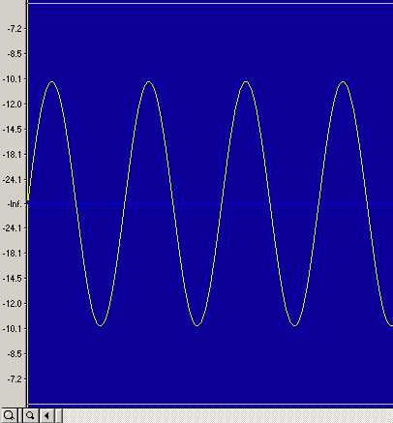

Some Basic Terminology
Oscillation – varying above and below a mean
Cycle – a complete unit of oscillation
Frequency – number of cycles per second (Hertz)
Period – time required to complete one cycle
Phase – portion of a cycle completed at a given moment (usually in degrees or radians)

Slide 4
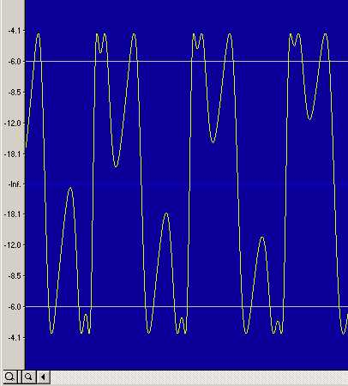
A Few More Terms
A “simple” or “pure” wave contains just one frequency, called the fundamental.
A “complex” wave contains other frequencies, as well.
Partials are multiples of the fundamental frequency.
Harmonic partials – integer multiples of the fundamental.
Inharmonic partials – non-integer multiples of the fundamental frequency.

Slide 5
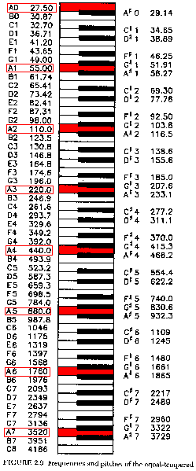
Perceived Pitch vs Frequency
Relationship between perceived pitch and physical frequency is not linear.
Each octave is twice the frequency of the one below it: they are powers of 2.
E.g., A5 (880Hz) is A4 (440Hz) * 2^1, and A4 (440Hz) = A1 (55Hz) * 2^3
A4 = A5 * .5 = A5 * 2^-1
In Equal Temperament, each semitone is exactly 1/12th of an octave, hence:
C5 (523.2Hz) = A4(440) * 2^(3/12)

Slide 6
Amplitude, Intensity, and Loudness
Amplitude – the change in pressure caused by a sound
Intensity – the "acoustic power" in a sound = Amp²
Loudness – a subjective measurement
The relationship between perceived loudness and physical amplitude (intensity) is non-linear.
The unit of measurement commonly used to describe loudness is the decibel, abbreviated dB. It is used to compare intensities or amplitudes. It is always defined in relationship to a reference value.
1 dB is considered the smallest perceivable change in intensity.
In acoustical power measurements, dB = 10 log(i1/i0)
In amplitude measurements, dB = 20 log(a1/a0)

Slide 7
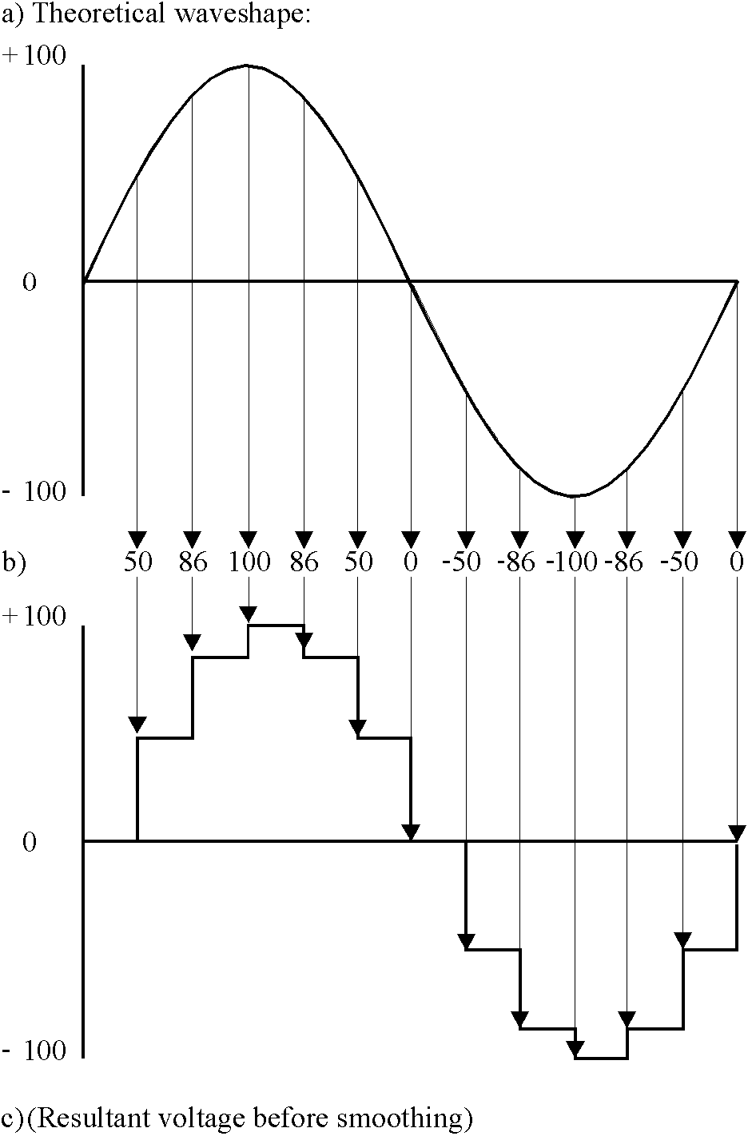
Digitizing Sound
Sound is a continuous phenomenon; in the analog studio, it may be represented by a continuous electrical signal.
Digital computers can only handle finite, or discrete, information. So we must to convert sound from the analog to the digital domain. This is called sampling.
Sample = amplitude of a signal at some instant in time. Samples must be evenly spaced to have any meaning.
Sampling Rate = N samples/Second. Standard audio rates are 44.1 KHz for CD and 48 KHz for DAT and ADAT.

Slide 8
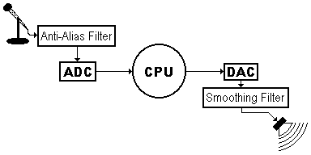
Analog/Digital Conversions
A Basic Digital Audio Setup
Microphone converts sound into an electrical signal
Anti-Alias “Brick Wall” filter removes very high frequencies from signal.
ADC periodically measures (samples) the amplitude of the analog signal, sending a stream of numbers to CPU.
DAC converts a stream of numbers into a stepped analog signal.
Smoothing filter removes staircase shape from signal.
Acoustical to Electrical to Digital (numerical) and back

Slide 9
The Limitations of Digital Audio
Nyquist Frequency (absolute frequency limit in a digital system) = SR / 2
Frequencies higher than N will “fold over” – i.e., they will “wrap around” N Hz:
Actual Frequency = SR – Intended Frequency
Familiar “Wagon Wheel” effect in old movies is actually foldover (see diagram next slide)
Practical frequency limit is about 80% of N
At CD rate (44.1 KHz), N = 22.05 KHz
Normal human hearing range = 20 – 20KHz

Slide 10
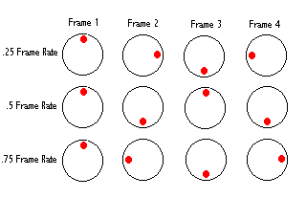
The “Wagon Wheel” Phenomenon

Slide 11
Limits of Amplitude
The Dynamic Range of a digital system is determined by the resolution (size in bits) of its digital/analog converters.
CD standard is 16 bits (also Csound’s)
Largest possible unsigned value in a 16 bit integer sample is 2^16, or 65536
Range of signed values is –32768 to 32767
In Csound, “samples out of range” will be clipped to the maximum possible values.

Slide 12
Csound Amplitudes vs dB
Amp dB
32767 | 0 dB
16384 | -6 dB
8192 | -12 dB
4096 | -18 dB
2048 | -24 dB
1024 | -30 dB
512 | -36 dB
256 | -42 dB
128 | -48 dB
64 | -54 dB
32 | -60 dB
16 | -66 dB
With 16-bit signed integer samples, the theoretical dynamic range is 90dB
The practical (usable) limit is closer to about 60-70 dB
Note how much more resolution there is at the higher end of the amplitude range.
Csound has built-in conversion functions (dbamp, ampdb, etc.)

Slide 13
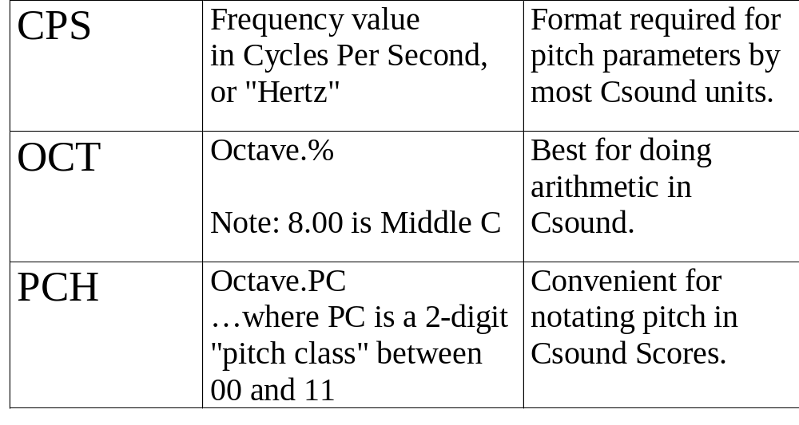
Pitch Representation in Csound

Slide 14
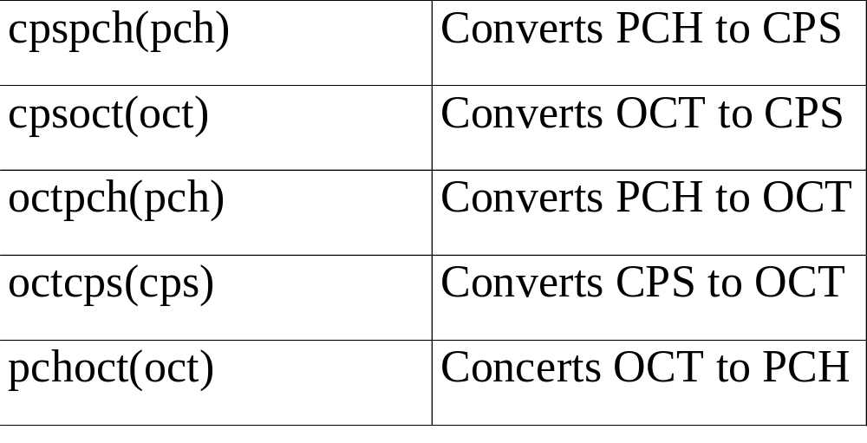
Csound Pitch Conversion Functions

Slide 15
Assignment One
    Visit course website
    Read the syllabus
    Read Online Primer: Intro and Chapter One
    Read Dodge: Chapters 1-3
    Download and install Csound on your computer (See www.csound.org for installation instructions)
    Lab Assignment 1:
      Code (type, don’t copy/paste) Sample Orc and Sco No. 1 from the Csound Primer and run them
      Name your files abc1.orc and abc1.sco (where abc are your initials) and turn them in to John Lato

